Slide 1
Kidney Exchange Program
Kjartan Þór Birgisson

Slide 2
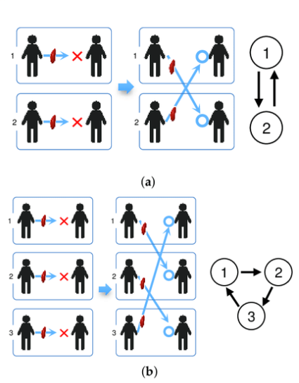
Kidney Exchange Program: Concept
A person in need of kidney transplant might have multiple persons willing to donate them a kidney.
No donor from that pool might be compatible.
People are much more likely to donate kidney to a friend or relative then a total stranger.
Solution: Create a pool of people in need of kidney transplant and along with the people willing to donate them a kidney.
Form kidney chains.

Slide 3
Kidney Exchange Program: History
First implemented in New England 2004 – 2005.
Alvin E. Roth – 2012 Nobel Memorial Prize in Economic Sciences.
Has been implemented all over the world.
3-way kidney chains considered optimal.
Longest kidney chain ever: 12-way exchange.

Slide 4
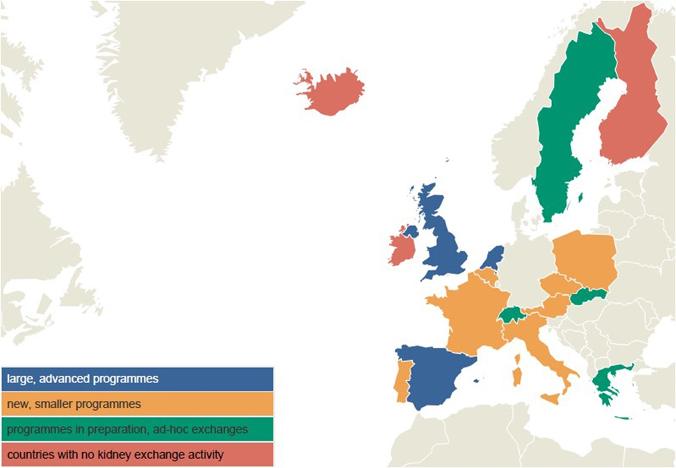
Kidney Exchange Programs: Europe

Slide 5
Kidney Exchange Program: Compatibility
Object: Minimize the likelyhood of kidney being rejected by kidney transplant recipient.
Blood Type: ˈAˈ, ˈBˈ, ˈABˈ, ˈOˈ
ˈOˈ can receive kidney from ˈOˈ
ˈAˈ can receive kidney from ˈAˈ or ˈOˈ
ˈBˈ can receive kidney from ˈBˈ or ˈOˈ
ˈABˈ can receive kidney from ˈABˈ, ˈAˈ, ˈBˈ or ˈOˈ
Rhesus (+/-), not important
Donor‘s Physcal Condition: Age, BMI, eGFR, SBP, History of Smoking

Slide 6
Kidney Exchange Program: Compatibility
HLA Antigen Matches
HLA-A
HLA-B
HLA-DR
Transplants performed even though several HLA mismatches exist

Slide 7
Kidney Exchange Program: Dataset
Complete:
Bloodtype Distribution - Vísindavefur
BMI Distribution – Landlæknir
History of Smoking Distribution – Landlæknir
Incomplete:
Systolic Blood Pressure Distribution – Hjartavernd
Heritage – Hagstofan
Missing:
HLA mismatches – deCode
eGFR – Landspítalinn

Slide 8
Kidney Exchange Program: Method
Genetic Algorithm
Sequence
Objective Function
Longest possible kidney chain
Lowest risk kidney chain
Maximum kidney chain size
Amount of kidney transplants possible at the same time

Slide 9
Kidney Exchange Program: Results

Slide 10
Kidney Exchange Program: Further work
Obtain the minimum criteria used by the Icelandic Health Care System to evaluate Donor/Recipient compitability - Ongoing
Obtain the incomplete and missing datasets in order to properly represent the Icelandic population
Estimate if a Kidney Exchange Program could be economically benificial for the Icelandic Health Care System

